Slide 1
Multi-tenant GPUs on Bare Metal OpenShift AI
A GitOps Blueprint from the Trenches Luca Berton · KubeCon Europe 2026

Slide 2
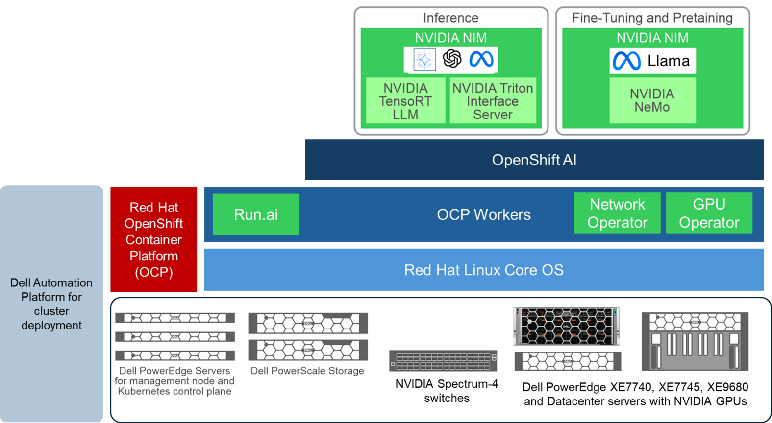

The Environment: Bare Metal, no Safety Net
Dell AI Factory bare-metal cluster — PowerEdge R660 control plane,
R670 CPU nodes and ESXi, XE7740 GPU workers
PowerScale scale-out NAS with RDMA w/OneFS
Latest OpenShift + OpenShift AI, NVIDIA GPU & Network Operators & Run:AI
NVIDIA GPUs H200 nodes in air-gapped environment
Air-gapped with local Quay mirror — no public registries
▎ No cloud abstractions. Every layer is ours to manage.
Dell Bare Metal
OpenShift
GPU/Net Operators
Quay Mirror

Slide 3

"It runs" ≠ "It's safe to share"
What we actually avoided from day one:
🔥 Noisy neighbors hoarding GPU memory → latency spikes
💀 Queue explosions → jobs starving, 'random wins' scheduling
🧩 MIG misfit → some workloads thrived, others crawled
💣 Driver drift → proprietary kernel modules + firmware mismatch
🌐 Network chaos → SR-IOV misconfigured, RDMA failures
▎ We needed guardrails. We needed a GitOps-driven framework.

Slide 4
The Framework
▎ Every decision filters through these three lenses.
🛡️ SAFE
⚖️ FAIR
⚡ EFFICIENT
Blast radius = zero One team can't break another
Contention is deterministic No more 'random wins'
Outcomes per GPU-hour Utilization ≠ useful work

Slide 5
Three Personas, One Platform
▎ The rule: if any one persona loses, adoption collapses.
👩‍💻 End-user
🔧 LLMOps
🏢 Tenant Admin
"Give me a GPU fast, keep my latency stable"
"Repeatable across environments deploys, safe upgrades, full observability"
"Enforce my boundaries, show me the bill"

Slide 6
🔄 GitOps: Everything is Code, Auditable
Argo CD / OpenShift GitOps as the single source of truth
gitops/
├── cluster-config/ # Kustomize base + overlays
│ ├── base/operators/ # GPU Op, Network Op, SR-IOV
│ ├── base/infra/ # StorageClasses, Network
│ └── overlays/prod/ # Patches: quotas, OAuth
├── applications/ # Helm apps (per-env values)
└── argocd/ # Root apps + ApplicationSets
Git Commit
Pull Request
ArgoCD Sync
Platform

Slide 7
🚀 Bootstrap: bare metal to GitOps
Ansible → initial handshake
Air-gap: Bootstrap Gitops & Quay
ImageDigestMirrorSet for mirrored registries
Local CatalogSources (redhat + certified indexes)
Quay CA trust + pull secrets
1
2
3
4
Install GitOps Operator (OLM)
Register Git repo in ArgoCD
Apply root App + AppSets
ArgoCD takes over (day-2)

Slide 8
🌐 Multi-tenant networking: HAProxy + Keepalived
SR‑IOV virtual functions for NIC isolation (per‑tenant network QoS)
Per-tenant logging via rsyslog → /var/log/haproxy-<tenant>.log
▎ All templated with Jinja2 — add a tenant = add a dict entry.
Keepalived VRRP MASTER/BACKUP
HAProxy vip_apps vip_apps
Tenant A NodePort
OpenShift Ingress
Tenant B NodePort

Slide 9
🛡️ Safety: reduce blast radius by design
Namespace isolation as the hard boundary:
Scoped ServiceAccounts — no cross-namespace verbs
RBAC least-privilege from day one
NetworkPolicy: deny-by-default between tenants
Pod Security / SCC guardrails; no privileged pods on shared nodes
Resource guardrails in Kustomize overlays:
ResourceQuota + LimitRange: CPU, memory, object counts - GPU via Run:AI
Admission webhooks catch misconfigs before deploy
RBAC + ServiceAccounts
NetworkPolicy (deny-by-default)
ResourceQuota + LimitRange
Admission Webhooks

Slide 10
🛡️ Safety: tenant bootstrap bundle
One kustomize build per tenant — deployed via Argo CD:
GitOps guarantee:
Tenant definitions in cluster-config/overlays/prod/patches/
Auditable, reviewable, rollback-able
▎ No tickets. No manual steps. Git PR = tenant provisioned.
Namespace
RBAC
NetworkPolicy
Quotas
HAProxy VIP

Slide 11
🔧 SR-IOV: NVIDIA Network Op vs NICs
Bare metal GPU nodes might have mixed NICs:
Example: SR-IOV network to a Pod via Multus
apiVersion: v1
kind: Pod
metadata:
name: testpod1
annotations:
k8s.v1.cni.cncf.io/networks: sriov-network
spec:
containers:
- name: appcntr1
image: registry.access.redhat.com/ubi9/python-311
imagePullPolicy: IfNotPresent
securityContext:
capabilities:
add: ["IPC_LOCK"]
command:
- sh
- -c
- sleep inf
resources:
requests:
openshift.io/sriovlegacy: '1'
limits:
openshift.io/sriovlegacy: '1'
NVIDIA ConnectX 7
• NVIDIA Network Operator
• Manages ConnectX SR-IOV + RDMA
• GPUDirect capable
Mellanox ConnectX 6
• OpenShift SR-IOV Net Operator
• Management traffic only
• Configured separately

Slide 12
⚙️ Open kernel modules + DMA-BUF
▎ Both changes reduced our upgrade failure
❌ BEFORE (Legacy)
✅ AFTER (Current)
• Proprietary .ko kernel modules
• nvidia-peermem for GPUDirect
• Tight coupling → upgrade fragility
• Open kernel modules (in-tree)
• DMA-BUF (upstream, kernel ≥ 6.x)
• Decoupled → safer upgrades

Slide 13
⚖️ Fairness: make Contention Deterministic
Without explicit rules, the loudest team wins.
Per-tenant GPU caps (hard quotas, not just requests)
PriorityClasses: training > batch, serving > interactive
Explicit preemption posture: who can evict whom
Scheduling constraints: labels, affinity, taints, tolerations
KAI Scheduler for GPU-aware scheduling + visibility
P0 — Training
P1 — Serving
P2 — Batch
P3 — Interactive

Slide 14
⚡ Efficiency: outcomes per GPU-hour
Time Slicing vs MIG vs full GPU decision matrix:
IO tuning on bare metal: GPUDirect RDMA via DMA-BUF over InfiniBand / RoCE and GPUDirect Storage (GDS)
Future plans:
NVLink-aware placement for multi-GPU training
Scale on queue depth + GPU saturation, not raw util
🟢 Interactive / Notebooks
Time slicing vs MIG slices — fast starts, fair sharing
🟡 Training
Time slicing vs Full GPU — avoid memory fragmentation
🔵 Inference
Time slicing vs MIG for predictability, full GPU for peak

Slide 15
🔄 The upgrade plan IS the platform
Known-good matrix (all managed in Git):
Upgrade flow:
Validation gate:
✅ Smoke training · ✅ Smoke inference · ✅ RDMA health · ✅ GPU errors
▎ Rollback: Git revert → Argo CD auto-syncs previous known-good.
GPU Op
Net Op
Driver
CUDA
Firmware
SR-IOV
Canary Pool
Bake 48h
Validate
Promote

Slide 16
📊 Make the invisible visible
Per-tenant monitoring:
Chargeback:
KAI Scheduler reports + cluster metrics → per-tenant GPU-hours
Tenant admins get self-service dashboards
▎ When teams can see their usage, behavior changes overnight.
⏱️ Queue Time
🖥️ GPU Metrics
📈 Latency
🌐 Network
by priority class
util, memory, thermal
p50/p95 via HAProxy
RDMA + SR-IOV VF

Slide 17
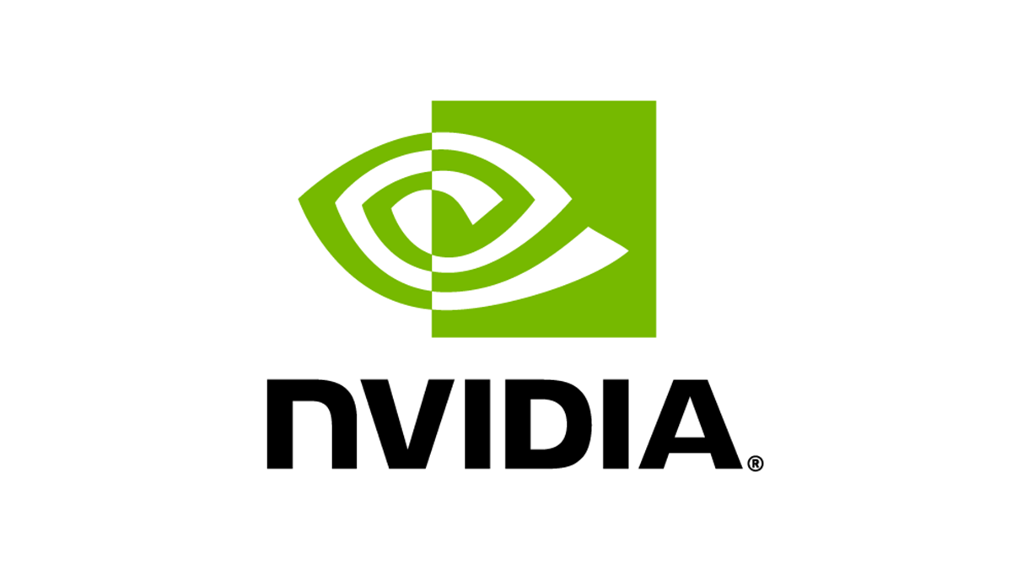

Demo
Safety‑First Multi‑Tenant Platform Engineering

Slide 18
🔧 Seven Guardrails You Can Apply Today
▎ Start with #1 and #2 — they fix 60% of multi-tenant GPU pain.
1
GitOps-first
Argo CD + Kustomize
2
Tenant template
NS + RBAC + NetPool + VIP
3
Quotas & limits
GPU, CPU, memory
4
SR-IOV per vendor
NVIDIA vs Intel NICs
5
Open modules
DMA-BUF GPU stack
6
Observability SLOs
queue, latency, saturation
7
Upgrade playbook
matrix, canary, rollback

Slide 19
Multi-tenant GPUs on bare metal work when...
Thank you
🛡️ Safety is provable
Enforced by RBAC, NetPool, quotas — in Git.
⚖️ Fairness is explicit
Encoded in priorities and preemption — via Argo CD.
⚡ Efficiency is measured
Tracked per tenant, per GPU-hour.

